Slide 1
Radiation Safety Training PE Wizard® Gamma Counter
CSULB Radiation Safety Office
March, 2013
Notes:
This template can be used as a starter file for presenting training materials in a group setting.
Sections
Right-click on a slide to add sections. Sections can help to organize your slides or facilitate collaboration between multiple authors.
Notes
Use the Notes section for delivery notes or to provide additional details for the audience. View these notes in Presentation View during your presentation.
Keep in mind the font size (important for accessibility, visibility, videotaping, and online production)
Coordinated colors
Pay particular attention to the graphs, charts, and text boxes.
Consider that attendees will print in black and white or grayscale. Run a test print to make sure your colors work when printed in pure black and white and grayscale.
Graphics, tables, and graphs
Keep it simple: If possible, use consistent, non-distracting styles and colors.
Label all graphs and tables.

Slide 2
PE Wizard® Gamma Counter

Slide 3
Topics
What is a Gamma counter and how does it work?
Using the Gamma Counter—Step by Step Procedures
Things to Consider when using the Gamma Counter
Notes:
Give a brief overview of the presentation. Describe the major focus of the presentation and why it is important.
Introduce each of the major topics.
To provide a road map for the audience, you can repeat this Overview slide throughout the presentation, highlighting the particular topic you will discuss next.

Slide 4
What is Gamma Counter?
A Gamma counter is a type of scintillation counter that measures ionizing radiation.
The Wizard Gamma Counter has a solid scintillator made of sodium iodide which generates photons of light in response to incident radiation.
A sensitive photomultiplier tube (PMT) measures the light from the scintillator. The PMT is attached to an electronic amplifier and other electronic equipment to process the signals produced by the photo-multiplier.
Notes:
This is another option for an Overview slides using transitions.

Slide 5
Detector diagram

Slide 6
Gamma Counter Overview
No Liquid Scintillation Cocktail used.
Liquid or solid samples added to tube, tubes are capped.
Capped tubes placed in racks, racks placed on conveyor.
Counting method selected using touch pad and viewing screen, counting is started.

Slide 7
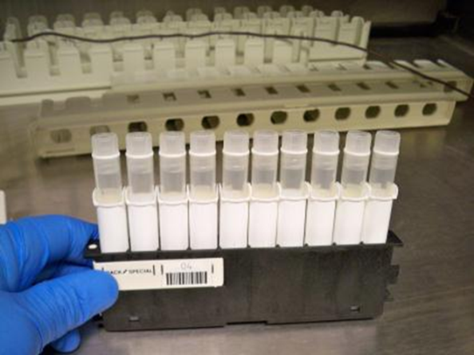
Using the Wizard Gamma Counter
Capped tubes added to rack.

Slide 8
Using the Wizard Gamma Counter
Racks placed on conveyor

Slide 9
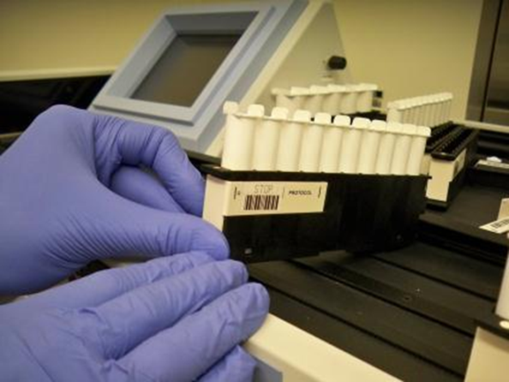
Using the Wizard Gamma Counter
Stop rack placed after samples (or use empty rack to “stop”)

Slide 10
Using the Wizard Gamma Counter
Samples loaded and ready for counting

Slide 11
Using the Wizard Gamma Counter
Sample run is initiated by pressing “start” on keyboard.

Slide 12
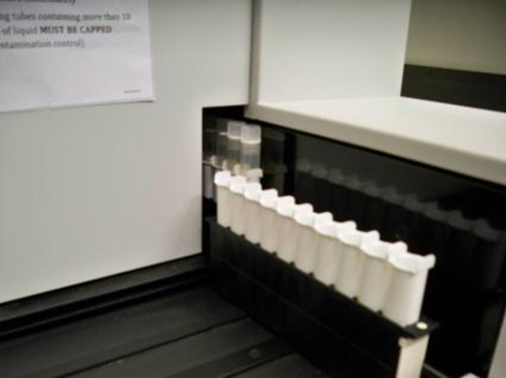
Using the Wizard Gamma Counter
Conveyor loads samples into chamber for counting.

Slide 13
Using the Wizard Gamma Counter
Don’t forget to sign the Log Book!

Slide 14
Using the Wizard Gamma Counter Rack ID.

Slide 15
Using the Wizard Gamma Counter Normalization for isotopes used
Normalization using a known source should be performed every 6 months.
See section 6.1.3 (pg. 76) for instructions.

Slide 16
Using the Wizard Gamma Counter --Type and size of tube.
All tubes must be capped with flush fitting cap (no overhang)
Caps like these will jam the sample handling mechanism when used in 10 sample rack.

Slide 17
Using the Wizard Gamma Counter --Type and size of tube.
If you use a tube with a snap-lid that overhangs the side, you may be able to use the larger 5 sample rack. Make sure your tubes are no taller than 100 mm so they fit into the sample well.

Slide 18
Using the Wizard Gamma Counter --Type and size of tube.
For the 10-tube rack, tubes up to 13 mm diam. X 100 mm height.
The 5-tube rack takes tubes up to 28 mm X 100 mm.

Slide 19
THE END

